Slide 1

Car price prediction
Team Members:
Sara Hassan Ahmed
Zohoor Samir
Horia Ahmed
Doha Ayman
Ziad Sameh

Slide 2
Introduction:
In this project:
We are predicting the price for every car using car price data set
Prerpcessing
Feature analysis
Correlation matrix and its visuliaztion
Grid search
prediction

Slide 3


Slide 4
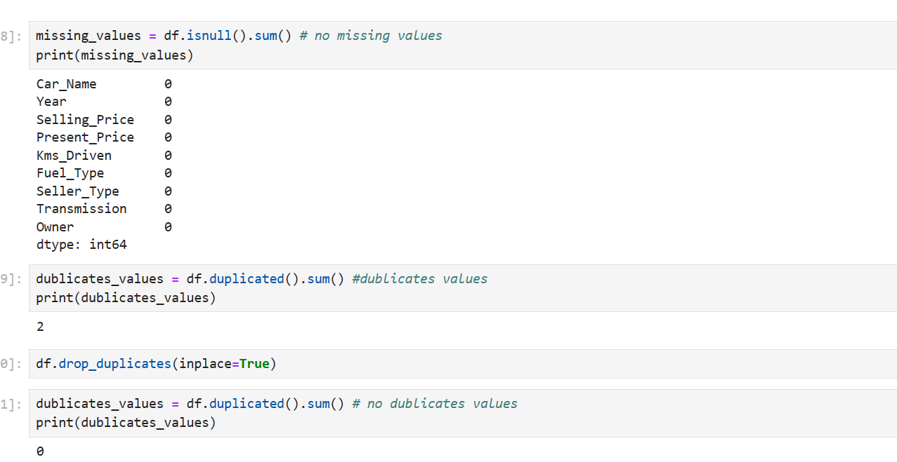
preprocessing

Slide 5
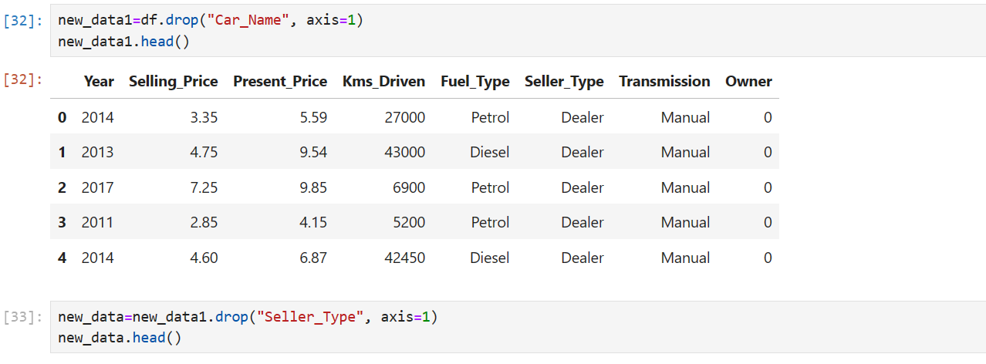

Slide 6
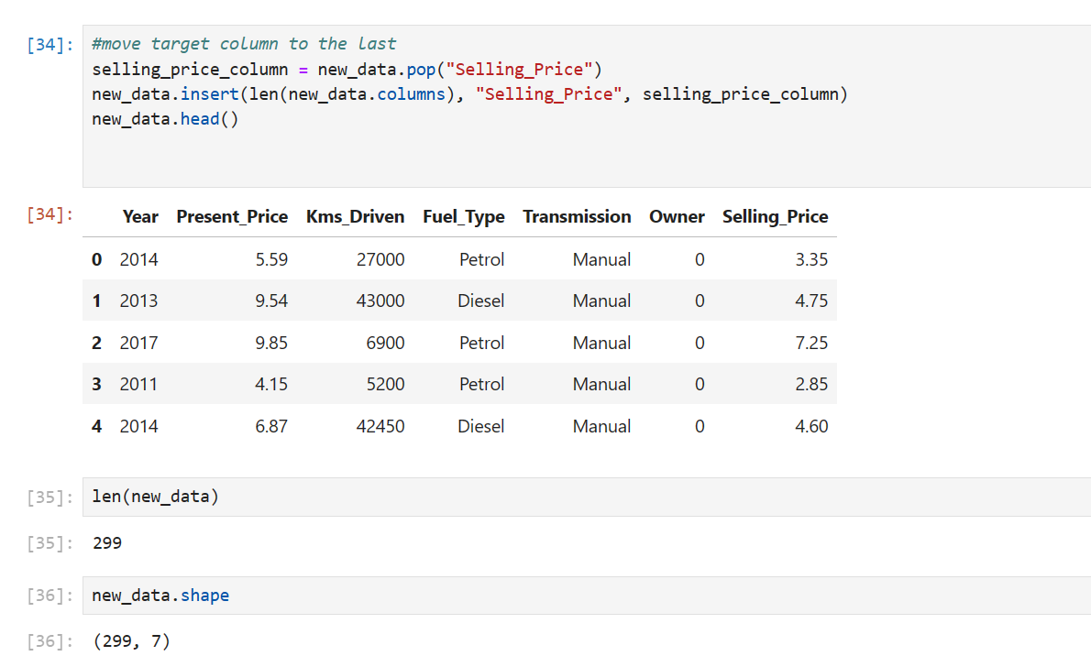

Slide 7
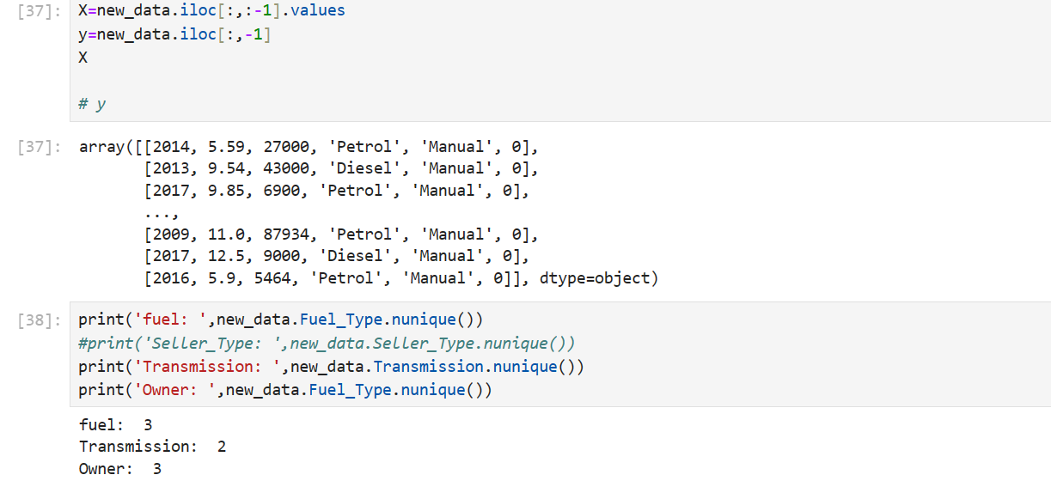

Slide 8
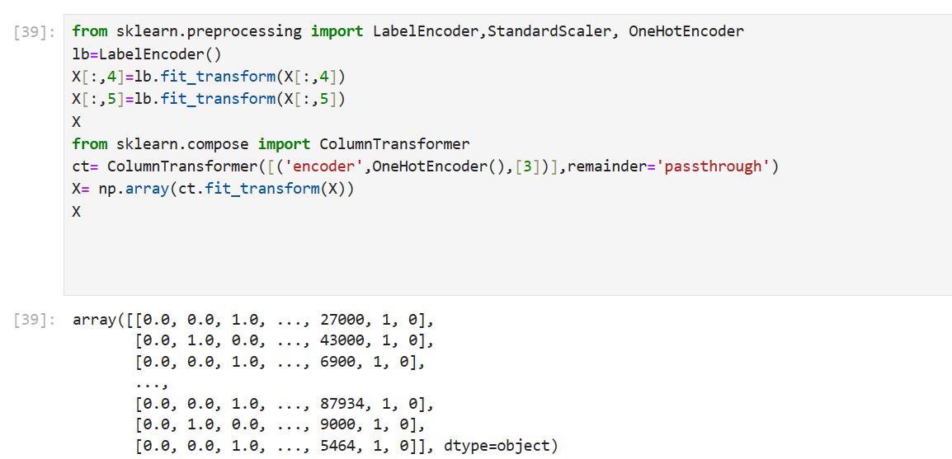

Slide 9
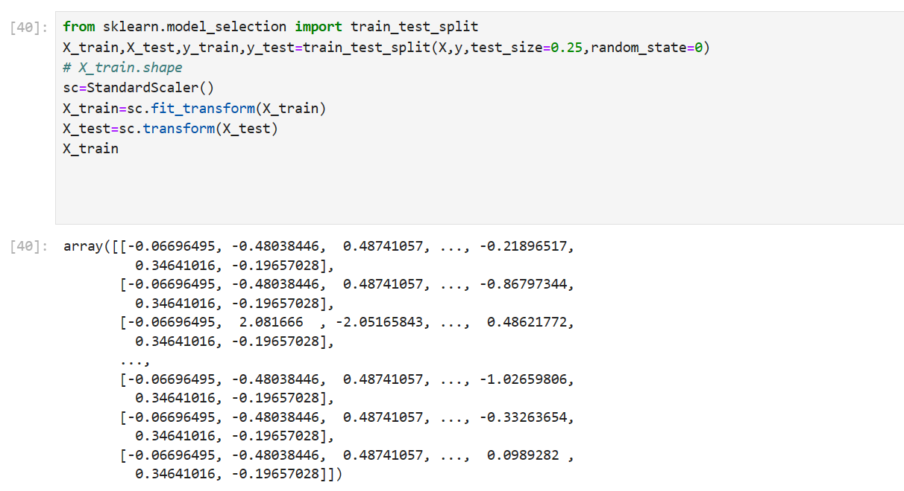

Slide 10


Slide 11
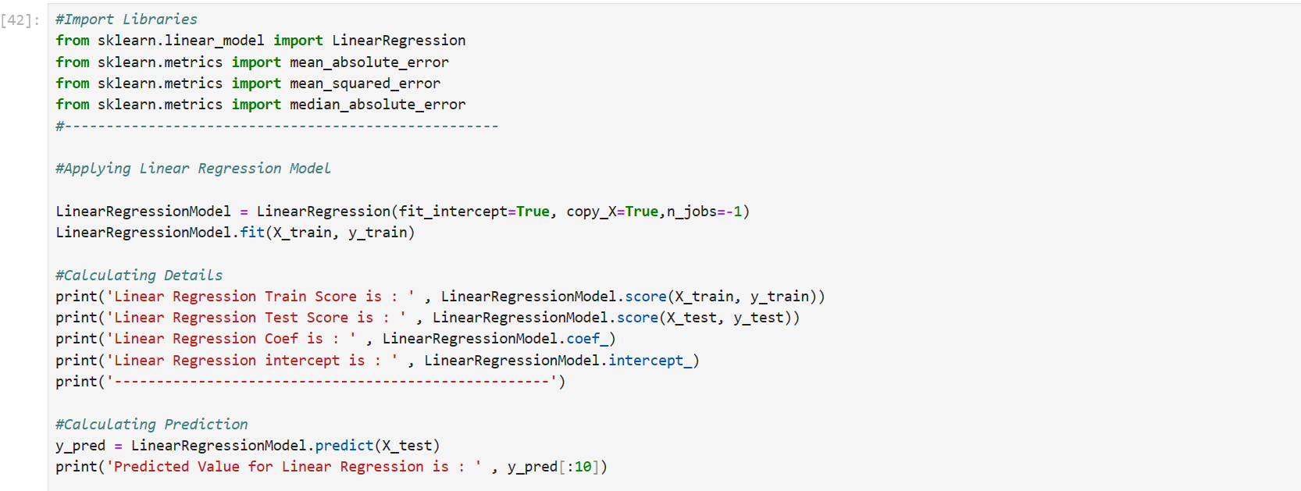
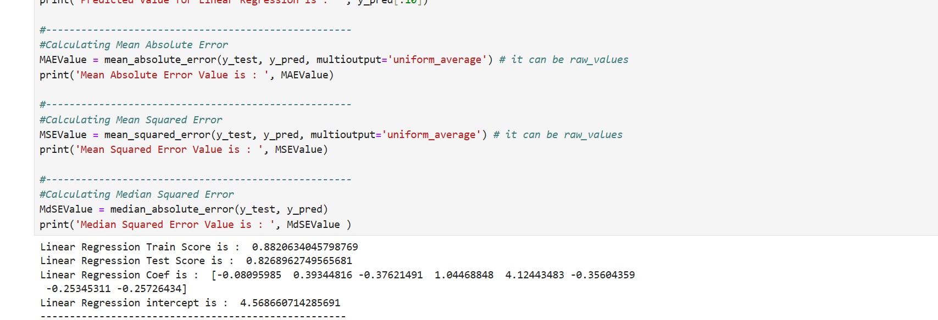

Slide 12
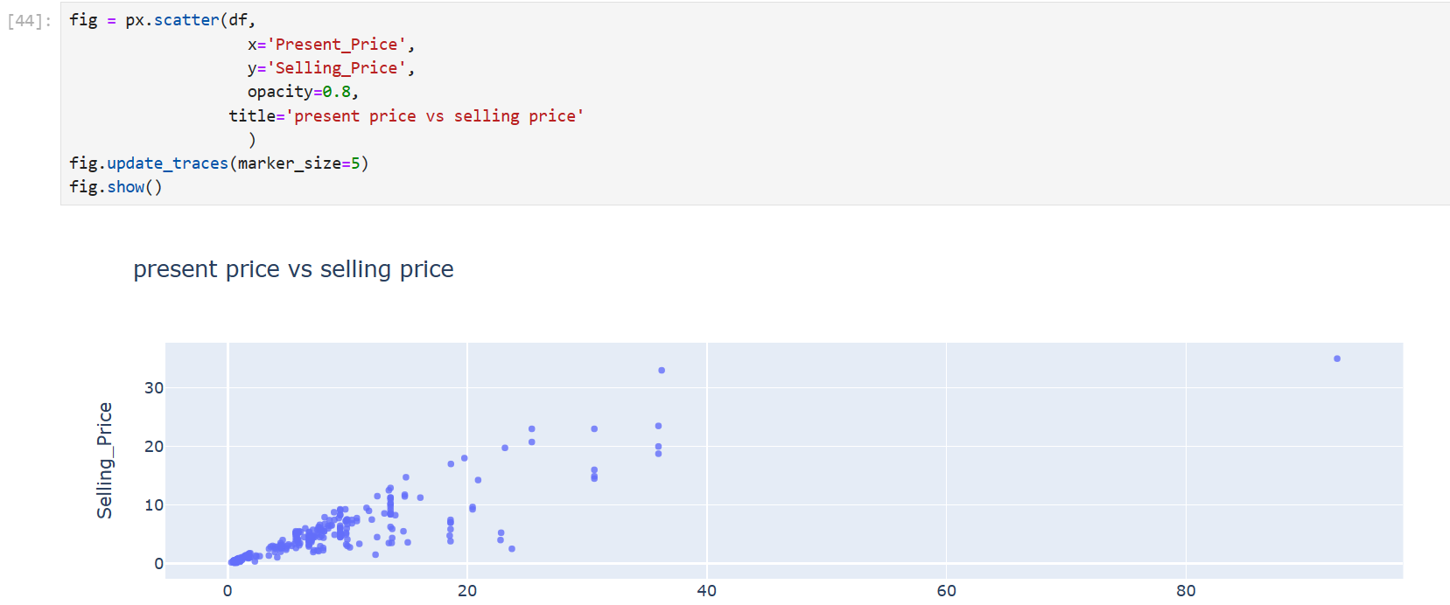

Slide 13
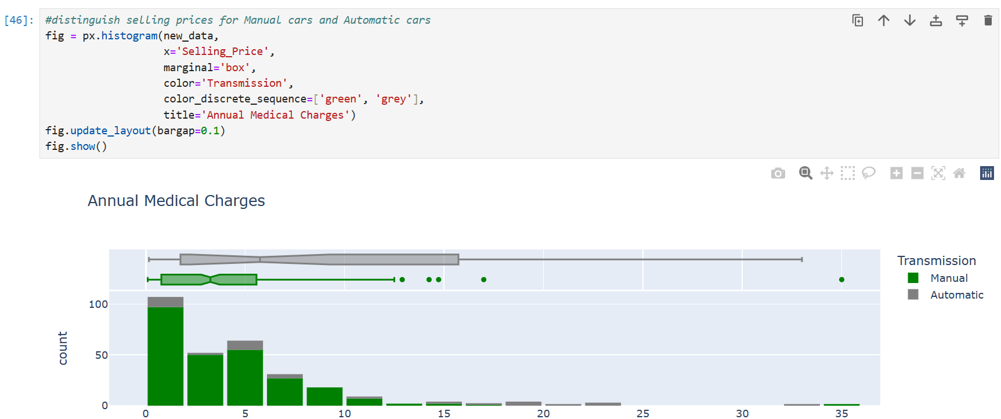

Slide 14
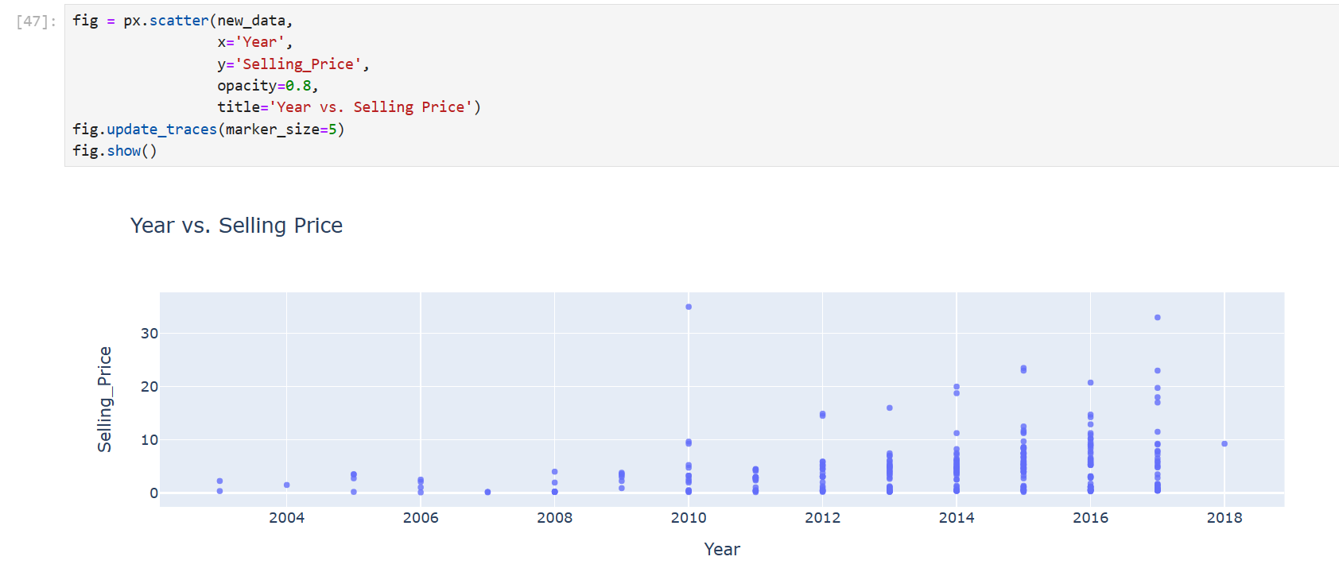
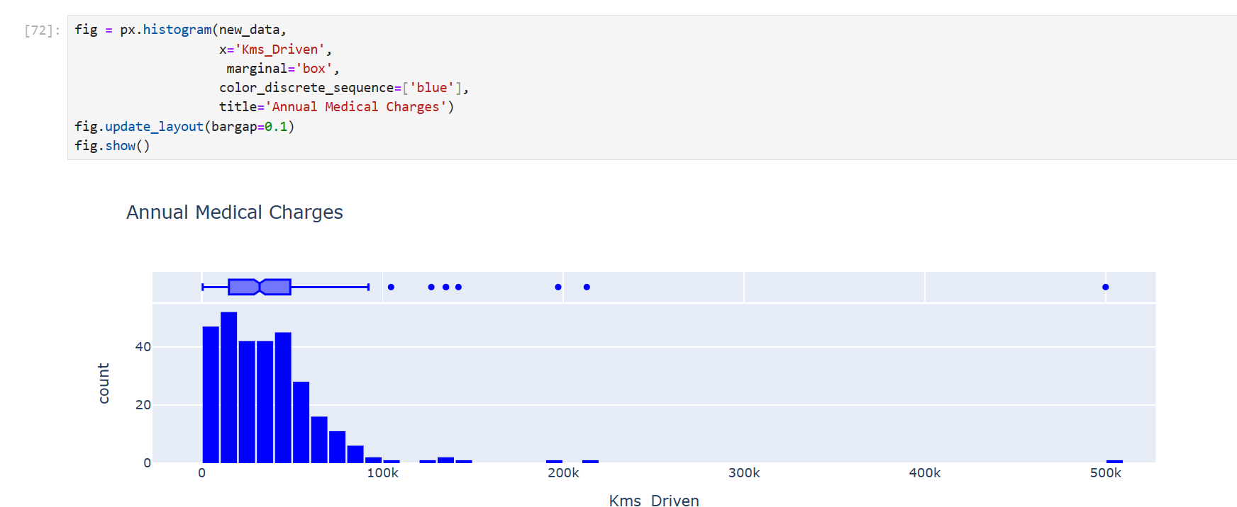

Slide 15


Slide 16
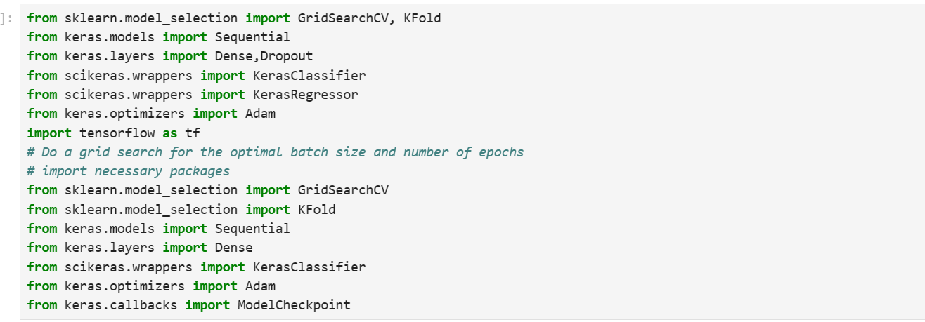

Slide 17
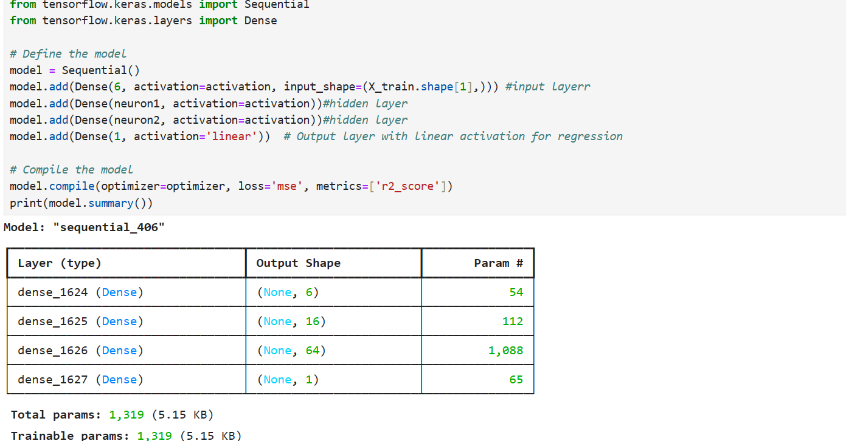

Slide 18
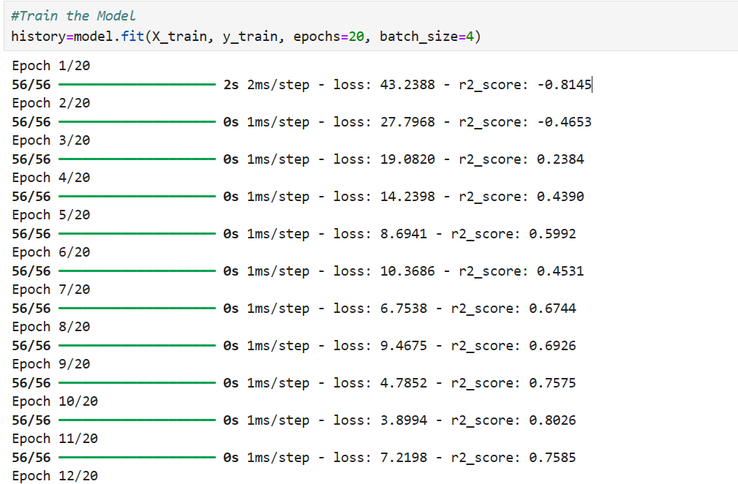

Slide 19
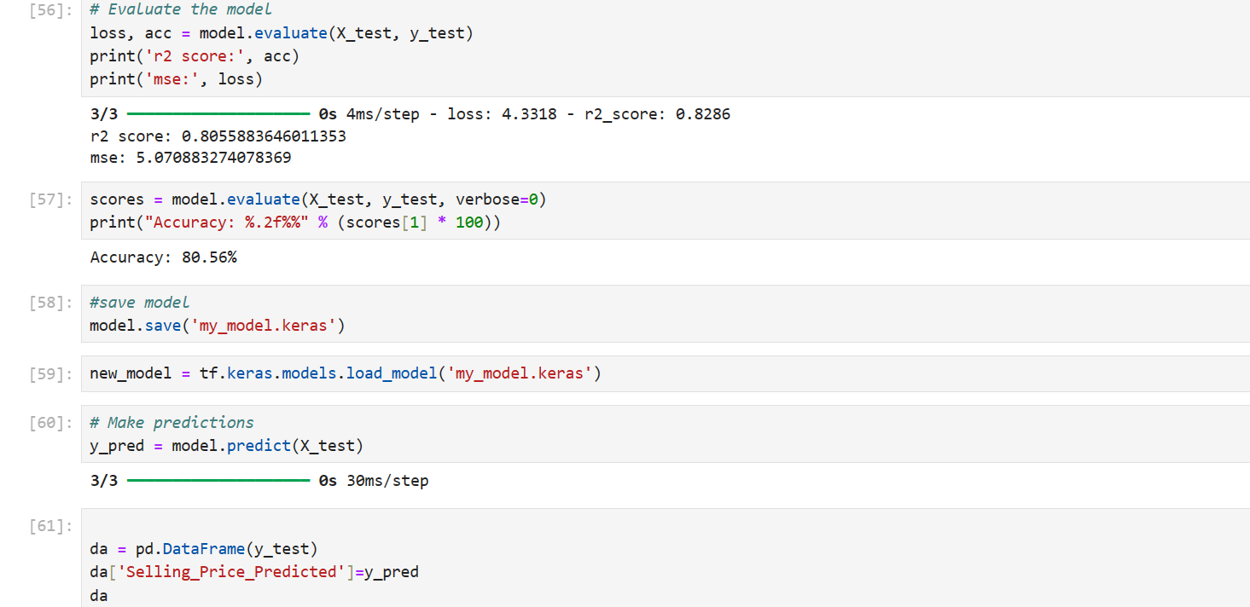

Slide 20

